Slide 1


Large Anisotropic Magnetoresistance and Magnetic properties of Single Crystalline, Tb₂Al₃Si₂
Yash Anand, Ram Kumar, Shanta Saha, Johnpierre Paglione
Maryland Quantum Materials Center,
University of Maryland, College Park
APS March Meeting 2024 W23.00012

Slide 2
Outline:
Background
Crystal Structure: X-ray Diffraction
Magnetism in Tb₂Al₃Si₂
Transport Properties: Anisotropic Magnetoresistance
Summary
APS March Meeting 2024 W23.00012

Slide 3
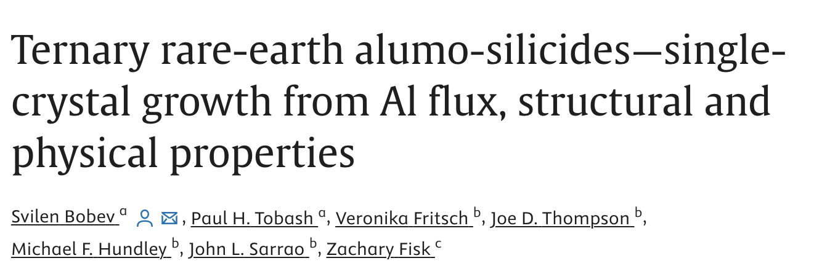
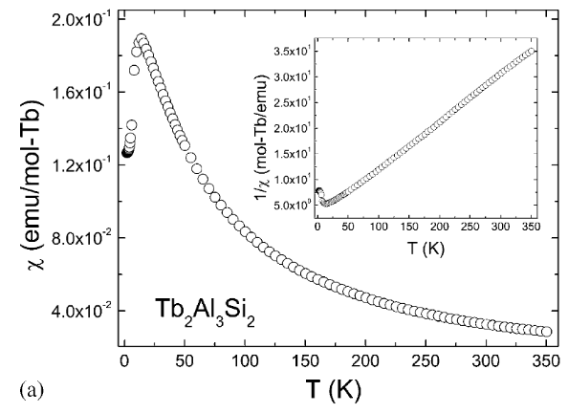
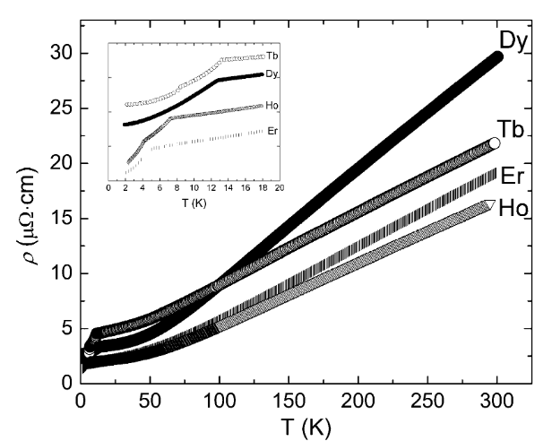


Background
https://doi.org/10.1016/j.jssc.2005.04.021
APS March Meeting 2024 W23.00012

Slide 4
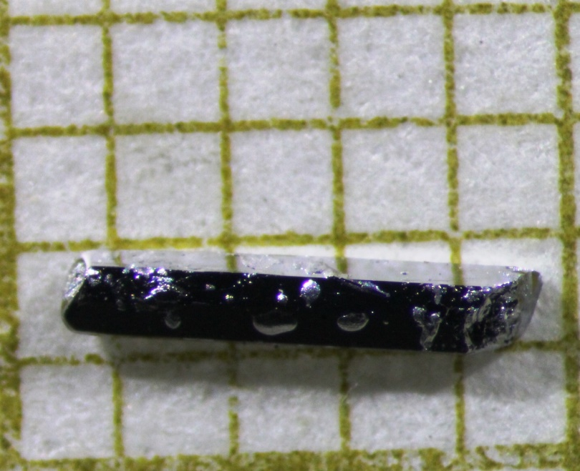
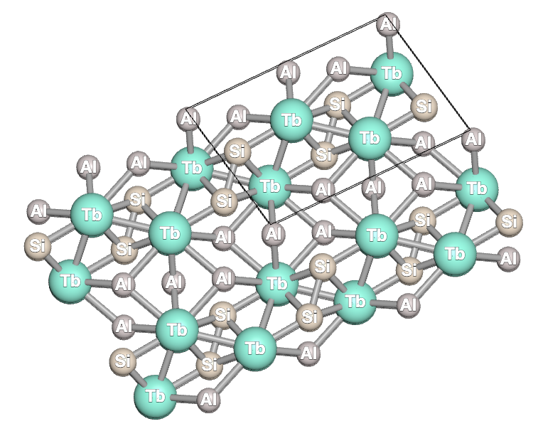
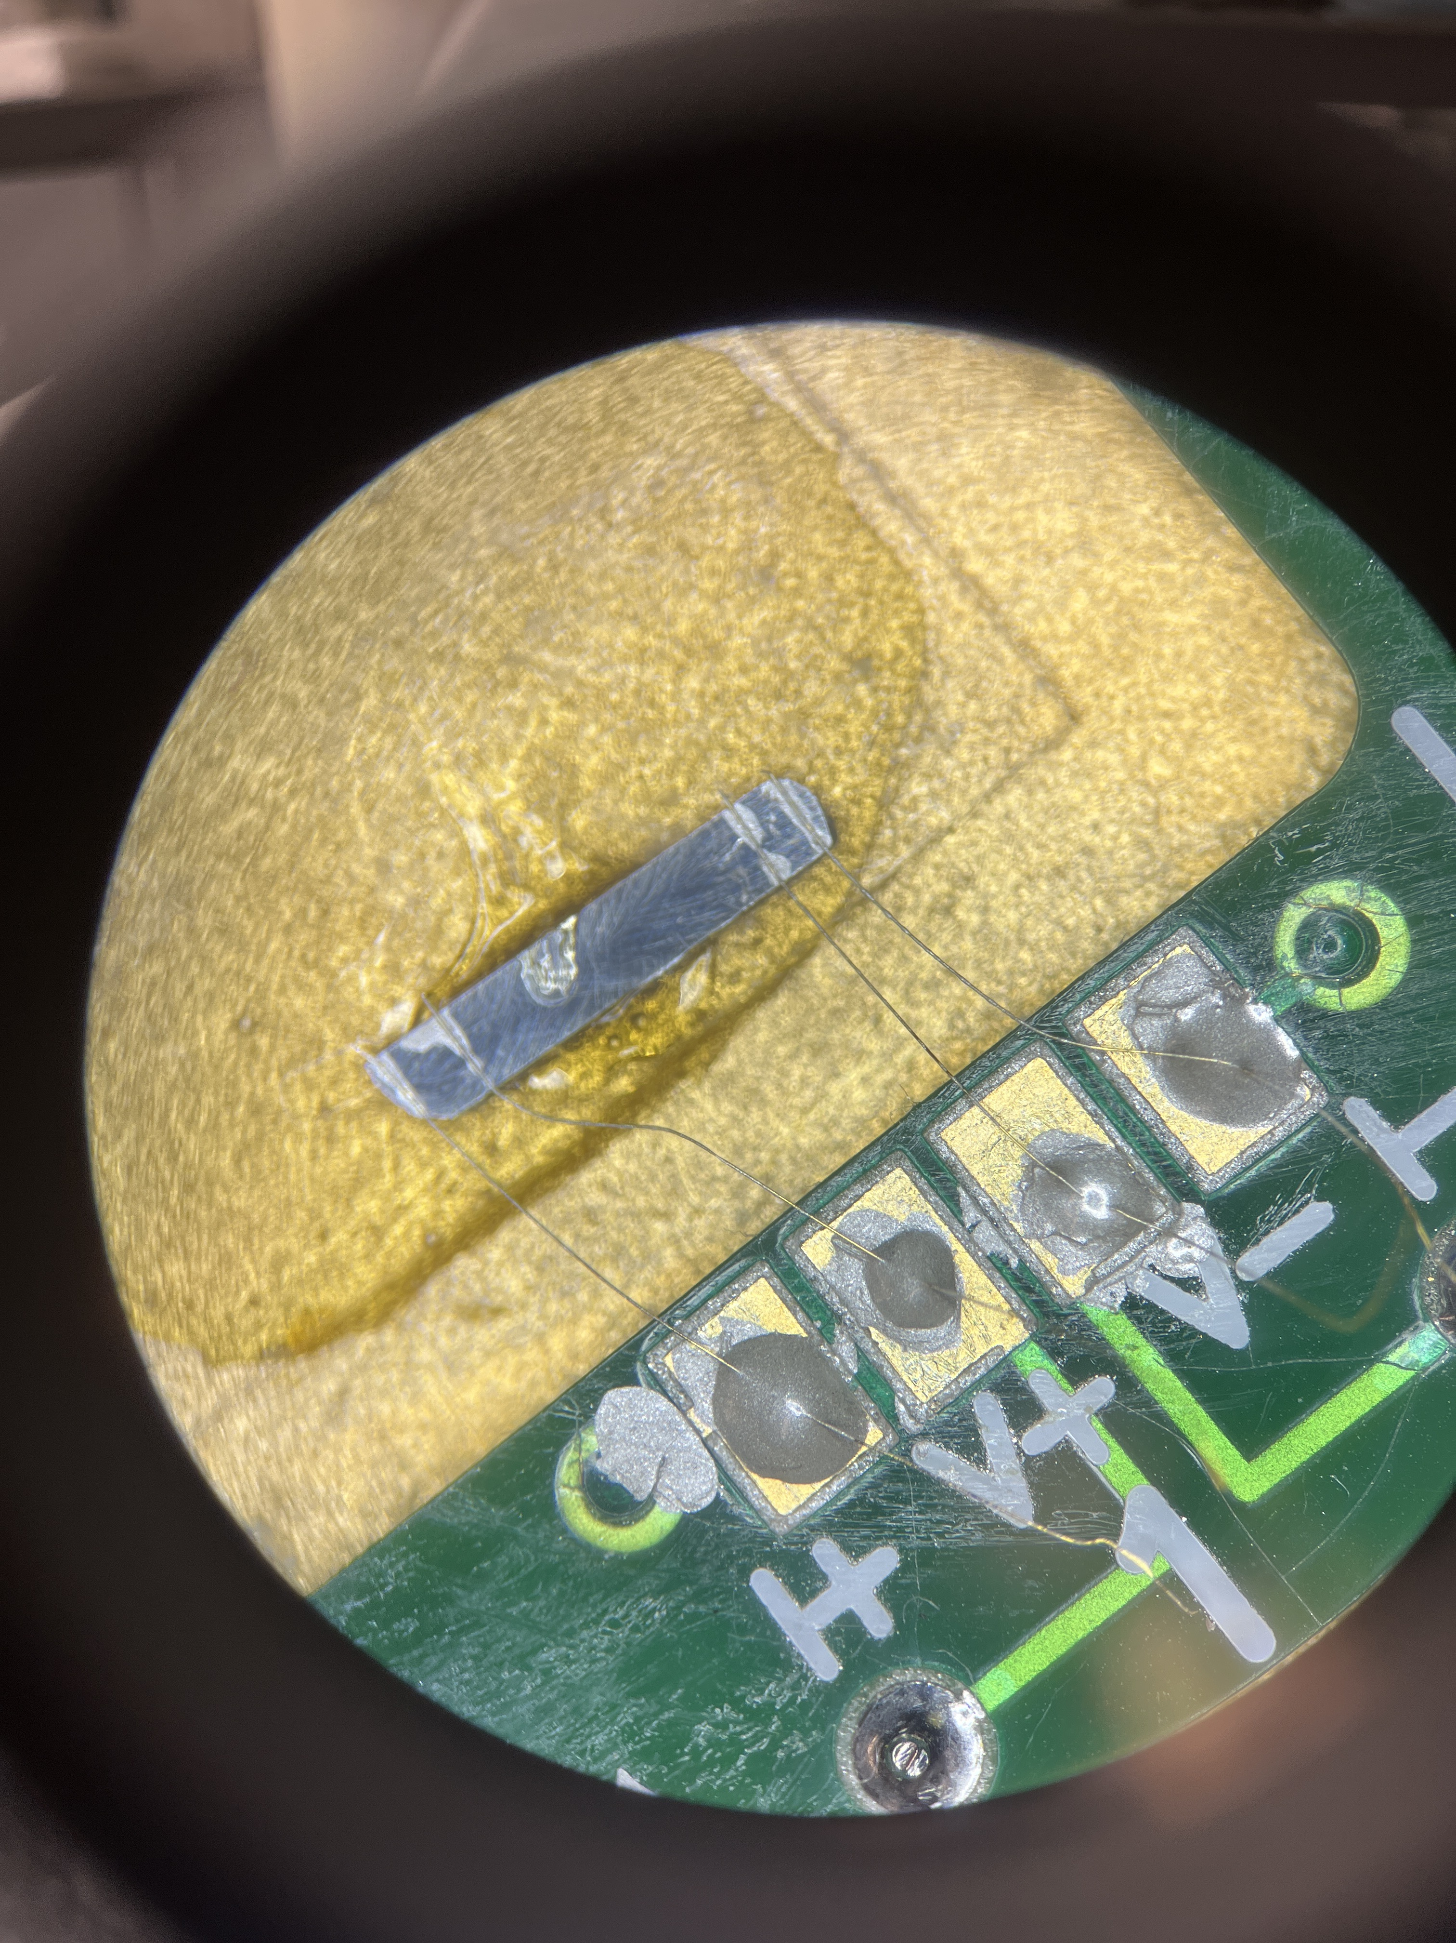
Crystal Structure: XRD
b-axis
https://www.topologicalquantumchemistry.com/#/detail/92448
1mm
b-axis
Name x y z occ.
Tb 4 0.61905( 14) 0.00000( 0) 0.32200( 21) 0 .473( 0) ~ 0.50
Si 4 0.90435( 54) 0.00000( 0) 0.35971( 80) 0.483( 0) ~ 0.50
Al 2 0.00000( 0) 0.00000( 0) 0.00000( 0) 0.259( 0) ~ 0. 25
Al 4 0.30098( 63) 0.00000( 0) 0.12840( 84) 0.515( 3) ~ 0. 50
Lattice parameters:
a=10.179(1) Å, b=4.038(1) Å , c= 6.600(2) Å and α = γ = 90 °, β= 101.2° (1)
APS March Meeting 2024 W23.00012

Slide 5
Magnetic Properties: H || b
3K
5K
1.8K
7K
10K
Tn1 ~ 13K
Tn2 ~ 8K
15K
APS March Meeting 2024 W23.00012
Notes:
Small mag field, 2 transitions around 13K and another at 8K
Spin glass features because ZFC and FC bifurcation
First plot full sweep but others are only first quardanent
At different temperatures there is a hysteresis which shifts towards low fields as temperature increase, showing complexity of magnetic structure

Slide 6
Magnetic Properties: H ⟂ b
APS March Meeting 2024 W23.00012
Notes:
When Hperp to b shows further complexity in magnetic structure, as you can see from the MvH plot.

Slide 7
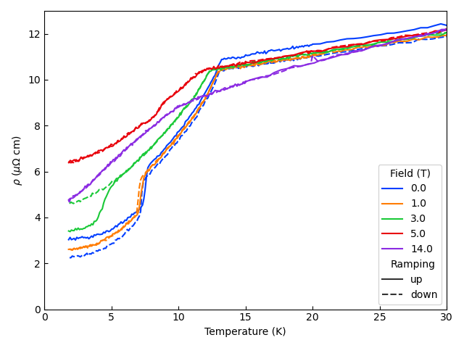
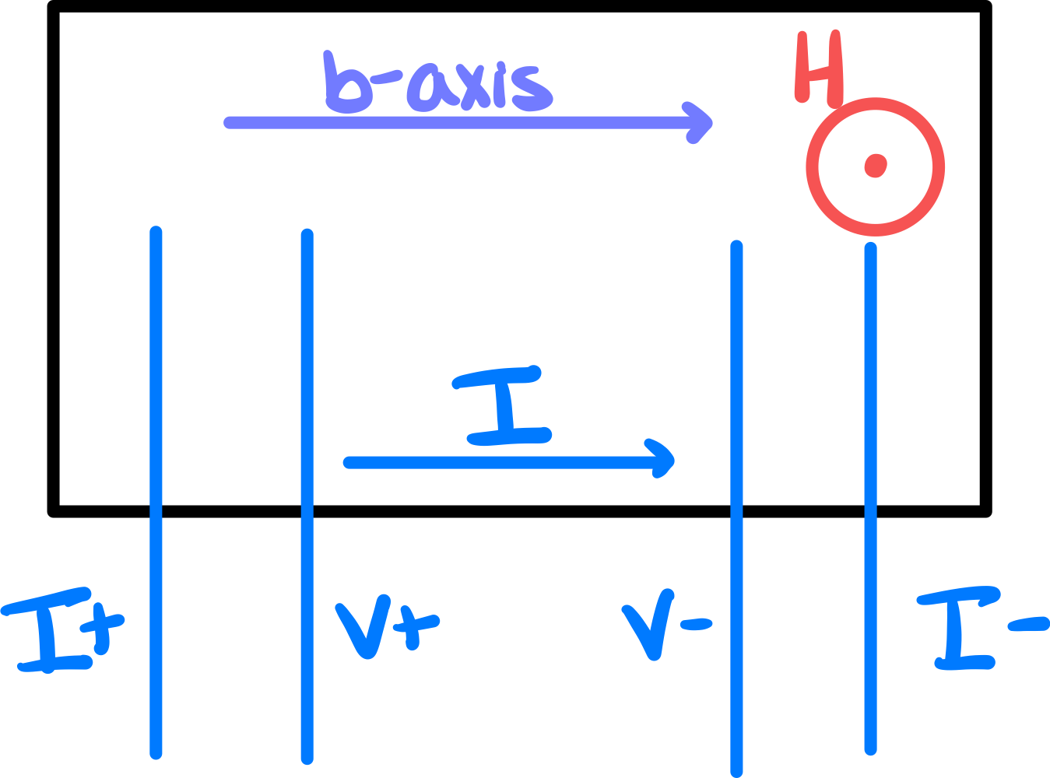
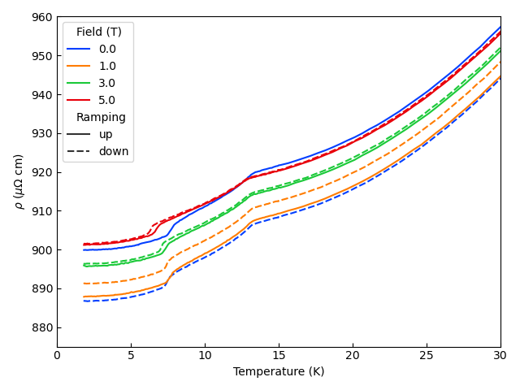
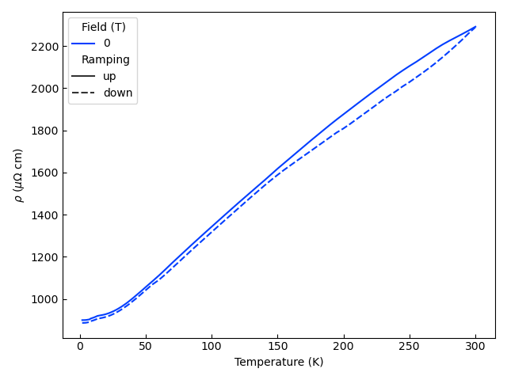
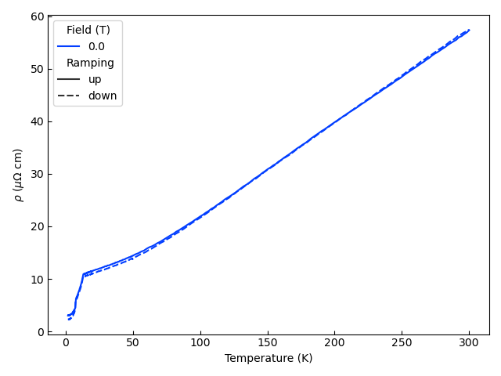
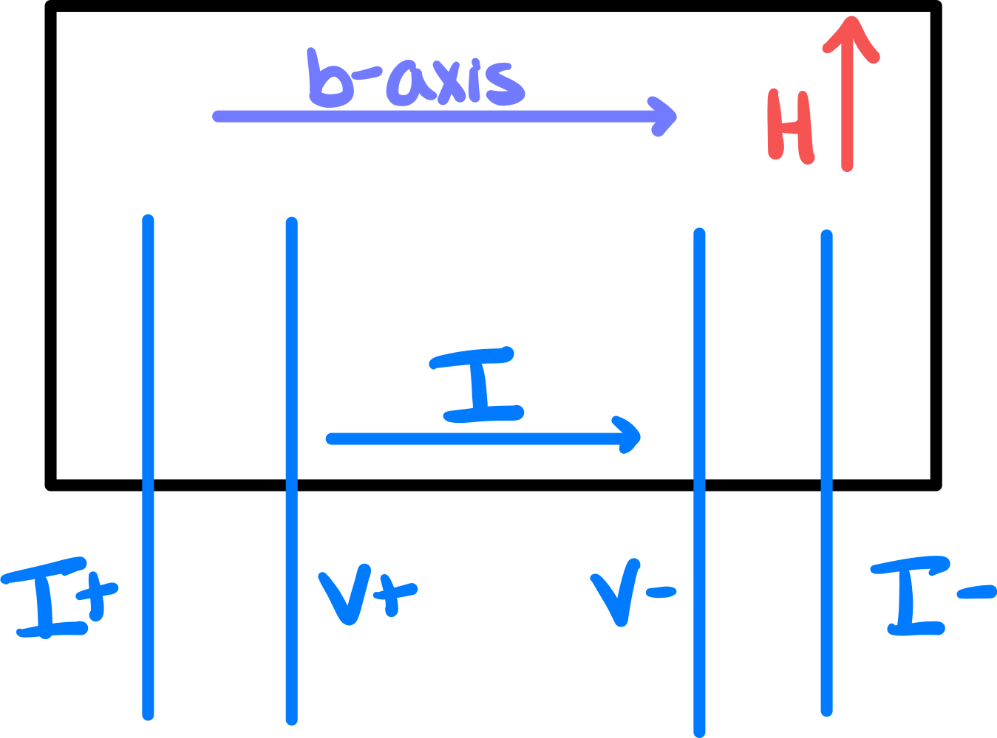
Transport Properties
APS March Meeting 2024 W23.00012
Notes:
No report on magnetoresistnac, we see the same transition at 13K and 8K as we saw in the magnetization. Even though it looks more complex in resistivity. Along different field orientation we see different response in resistivyt.

Slide 8
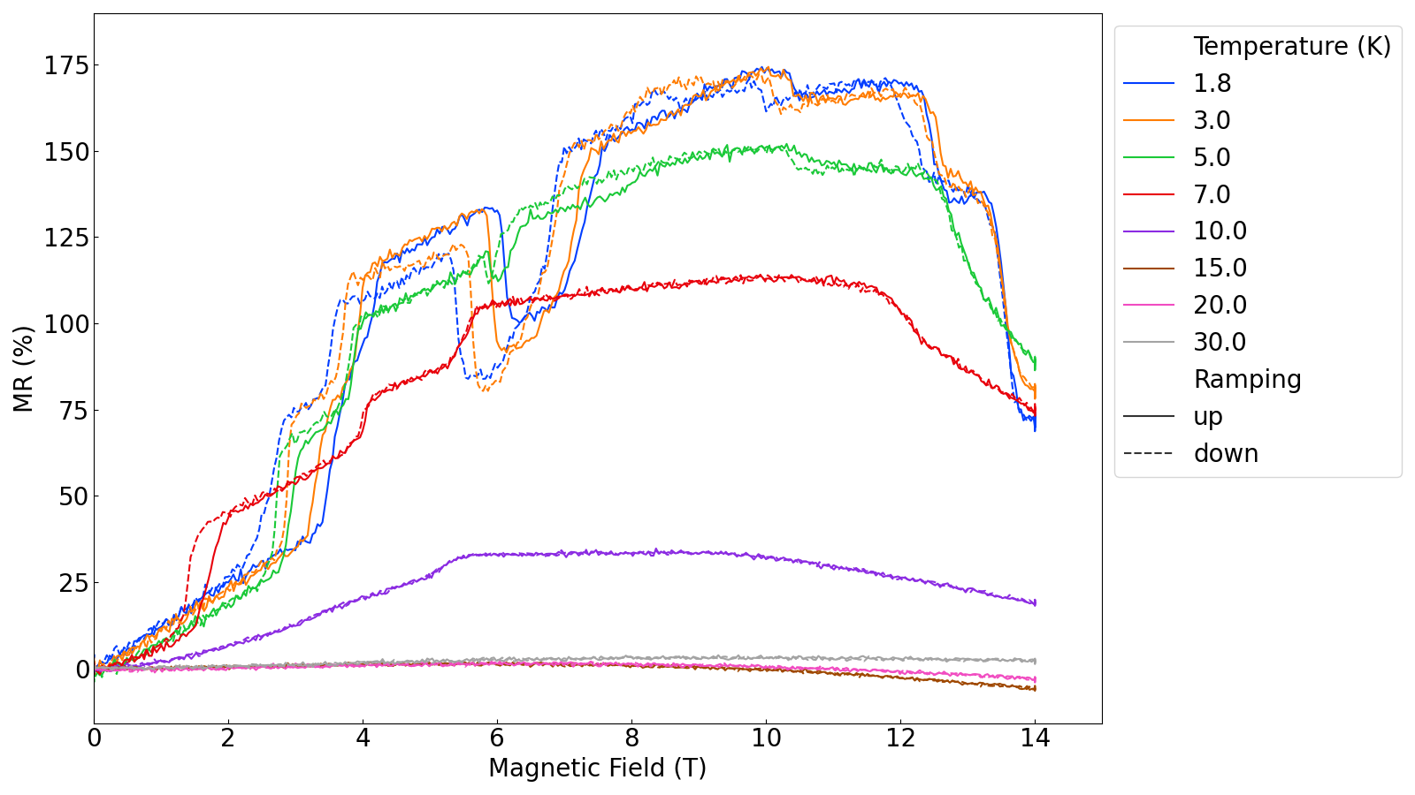
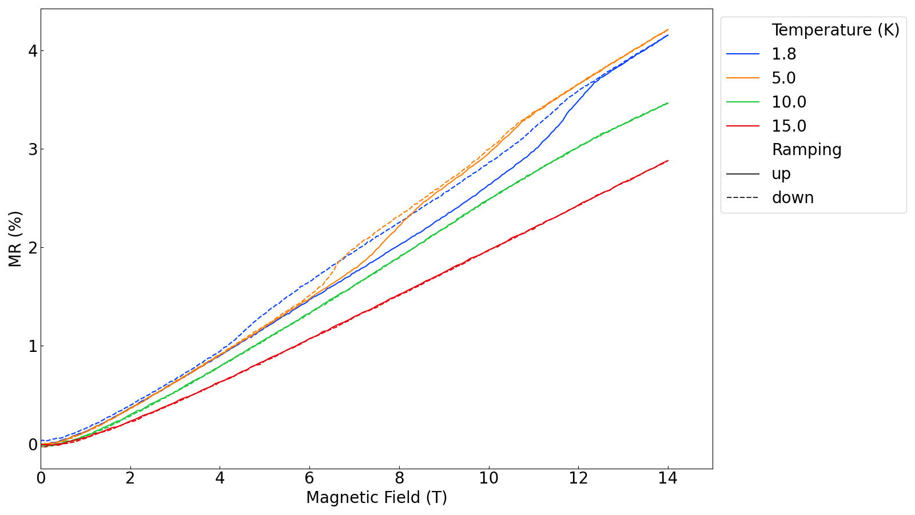
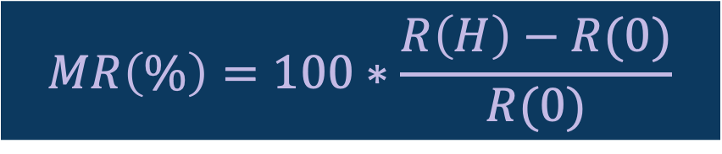
Magnetoresistance
$$MR\left(\%\right)=100∗\frac{R\left(H\right)−R(0)}{R(0)}$$
APS March Meeting 2024 W23.00012
Notes:
Same orientation as the resistivyt we measured the resistivity as a function of field and calculated the magnetoresistance.

Slide 9
Summary
We grew large single-crystals of Tb₂Al₃Si₂
Using x-ray diffraction and Rietveld Refinement to determine the monoclinic structure of Tb₂Al₃Si₂
We studied complex magnetic properties showing the temperature and external field dependence of them
We show large anisotropic MR in Tb₂Al₃Si₂
Thank you so much for your attention!
APS March Meeting 2024 W23.00012
Notes:
Successfully grown nice large single crystal
Studied structural properties
Complex magnetic properties
Large Anisotropic MR in Tb₂Al₃Si₂

